Slide 1

Plastic & Reconstructive Surgery in Major Trauma

Slide 2
What you will learn
Knowledge of common plastic surgery techniques and indications for medical management e.g. debridement, SSG, flaps
Knowledge of the implication of the above on physiotherapy interventions

Slide 3
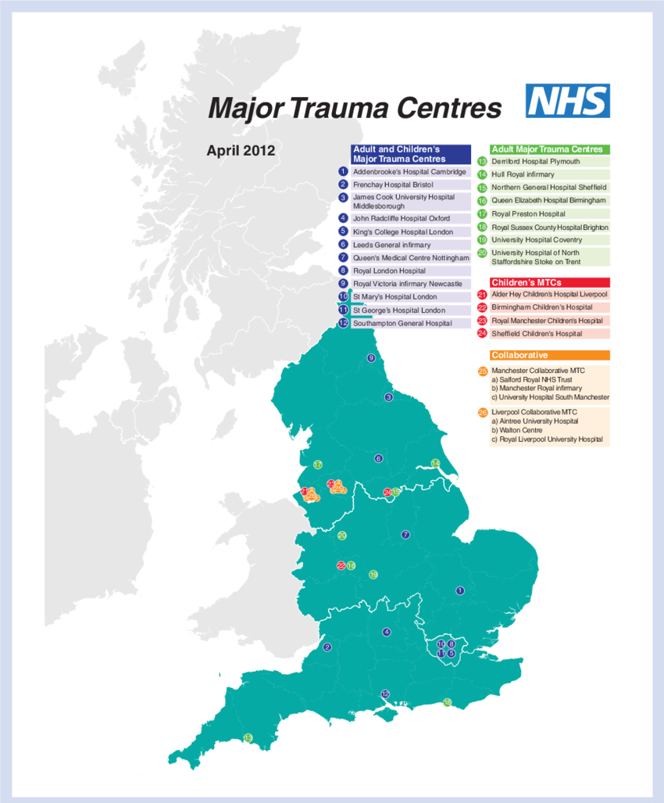
Major Trauma Network
15-25% all Major Trauma Surgical admissions involve plastics.
Lack of plastics in MT could be deemed a national clinical risk
Plastic Surgeons work closely with both the orthopaedic and vascular team in the limb saving and limb salvaging after major trauma.

Slide 4
Plastic Surgery
Plastic surgery has two main components: reconstructive plastic surgery which is all about restoring function and appearance to the human body after illness or accident and cosmetic plastic surgery which is done to change the appearance through choice.
Although you hear people mostly talking about cosmetic plastic surgery, the main work of nearly all plastic surgeons is reconstructive: covering all aspects of wound healing and reconstruction after congenital, acquired and traumatic problems as well as to restore the function of tissues and skin to as close to normal as possible. With cosmetic surgery playing a secondary, but important part.

Slide 5
Plastic Surgery Purpose
Using patients own tissue to reconstruct a deficit/open wound within the body.
"Robin Hood" principle: steal from Peter to pay Paul (as long as Paul can afford it!)
Donor tissue must be as close as possible in properties to recipient area requiring reconstruction.
Preparation of wound; washout/debridement/removal of non viable tissue.
Most common coverage:
  Skin graft
  Free flap
  Pedicled flap
  Or direct closure
Notes:
Using pts own tissue is key as the body is less likely to reject its own tissue. Surgeons know how much tissue Is needed to cover the defect.
The rule is using pts own stiss to cover a defect ensuring the areas you are taking the tissue from will not have a detrimental impact on the patient moving forward.
Essential to prep the would for the best chance of the transplanted?? Tissue taking to the new area of the body.
Types of coverage are
Direct closure – where there is enough excess tissue in the surrounding area to directly close and no extra tissue is required. Usually larger or older pts or areas with loose skin.

Slide 6
Debridement
Debridement is a procedure which involves thoroughly cleaning the wound from all infected and non viable tissue, foreign debris and residual material from trauma or dressings. Debridement can either be accomplished by surgical management or alternative methods using dressings or topical treatments.
Surgical management involves using a scalpel or surgical scissors to remove all affected tissue to healthy bleeding tissue.
Complications may include pain, bleeding, infection, delayed healing or loss of healthy tissue.
Topical management involves applying medication to the skins surface including the skin or mucose membrane to treat the affected area. Topical treatments can include creams, foams, gels, lotions, and ointments.
Notes:
Saline solution can be used to clean the would aswell as surgically removing non viable vissue

Slide 7
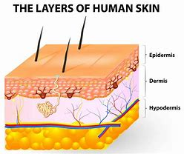
Skin Graft
A skin graft is where healthy skin is removed from an unaffected area of the body and used to cover lost or damaged skin.
Split-thickness graft: is composed of the top layer of skin, the epidermis, and some of the next layer, the dermis. Because some dermis is left, the donor area can heal. This is preferred for large areas and has the advantage of allowing harvesting. The success “take” rate for split-thickness grafts is 95%.
Full-thickness graft: has all skin layers. This also has a success rate of 95%.
The donor area usually take 2 to 3 weeks to heal and is pink for a few months before fading to leave a faint (hardly noticeable) scar.
Grafts very fragile
Immobilise 3-5 days if covering vulnerable area Lower limbs, can be on bed rest
Splinted if over joints

Slide 8
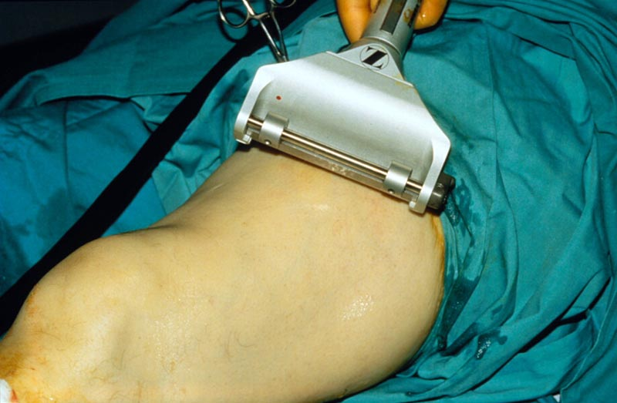
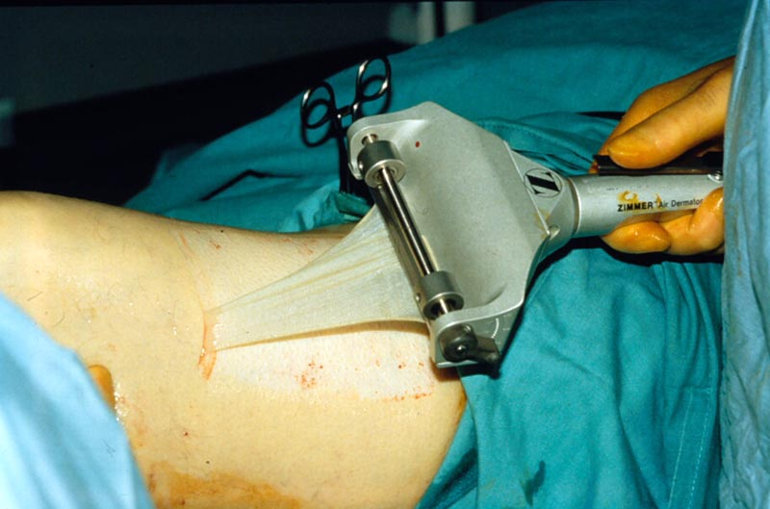
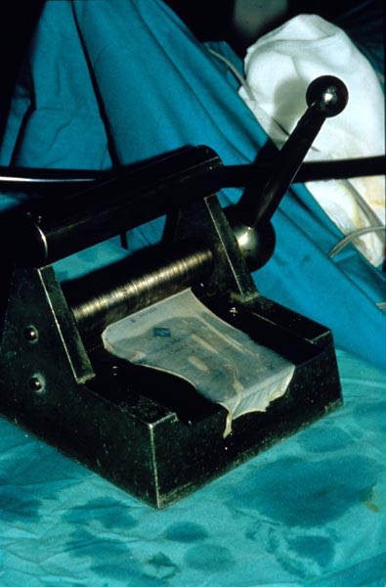
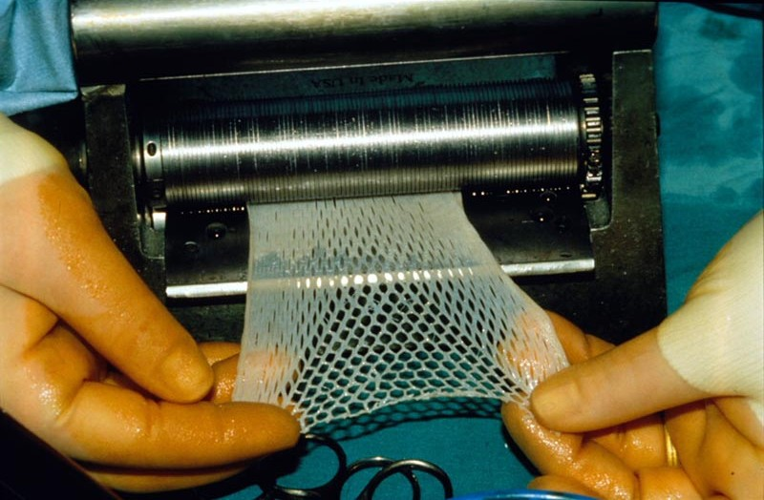
Notes:
Large layer of skin removed as one layer. This layer is put through a skin graft mesher. This allowed for bleeding to naturally occur and not build up under the graft causing a haematoma and for the graft to fail

Slide 9
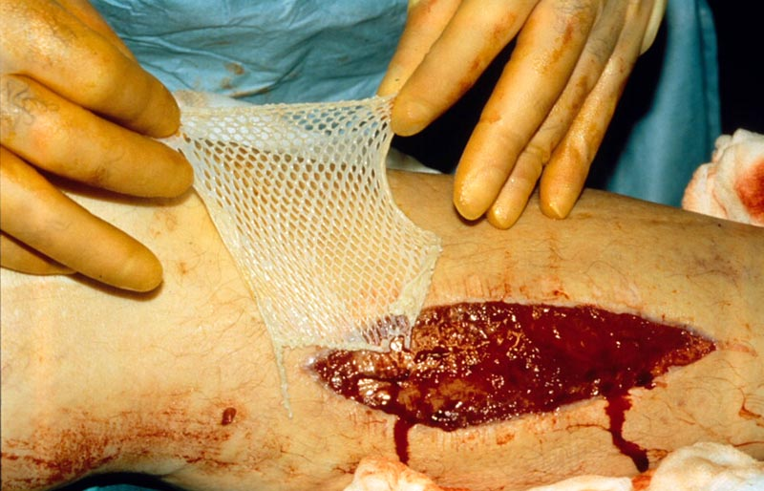
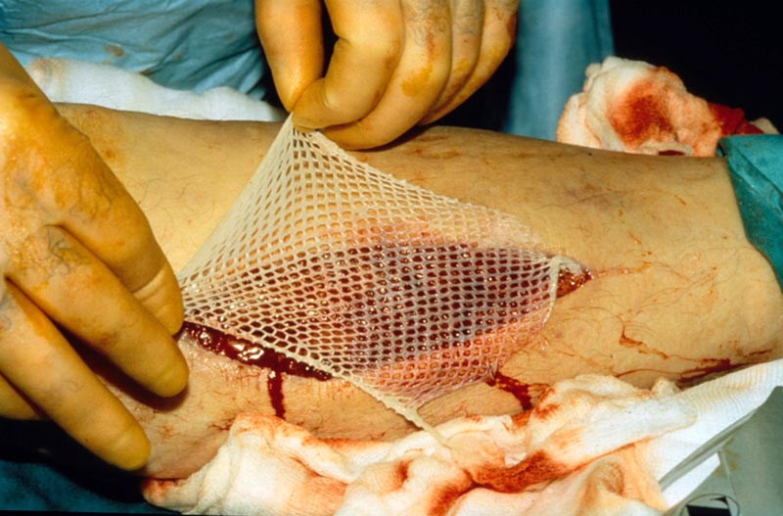
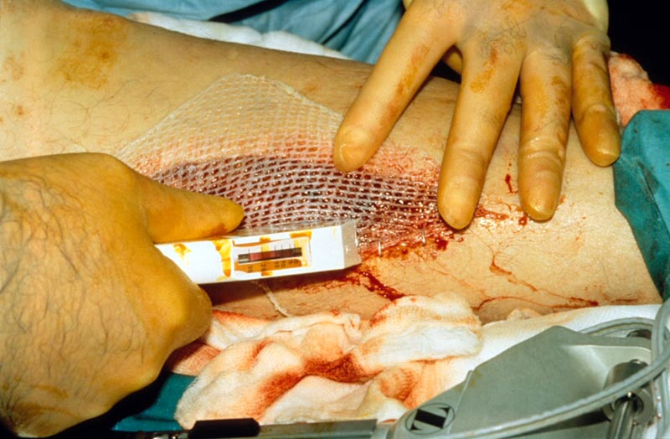
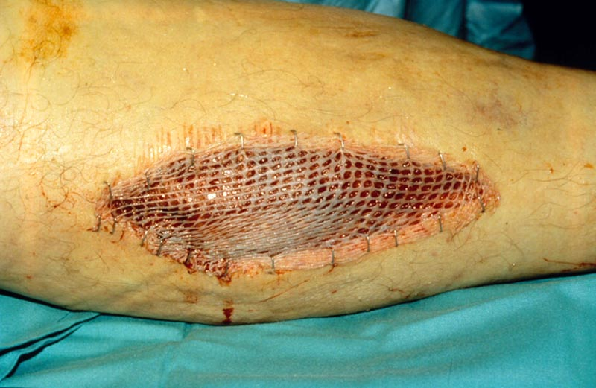
Notes:
The meshed piece of skin is placed over the area to cover and stapled down . Excess graft is trimmed away and the area is dressed appropriately with XXXX this dressing remains in place as stated in the op note

Slide 10
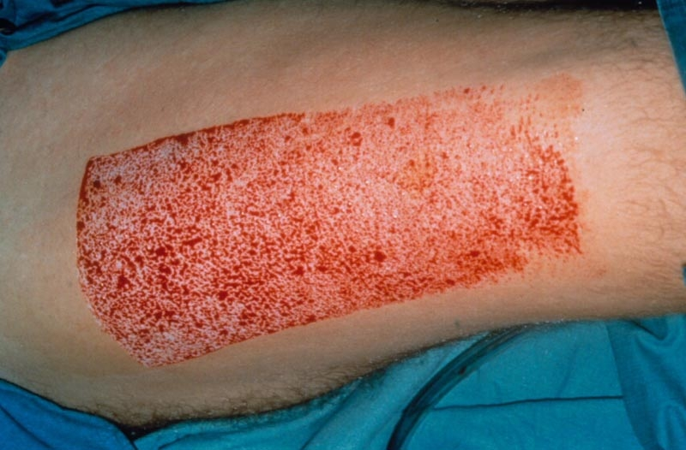
Donor Site
Notes:
The donor area usually take 2 to 3 weeks to heal and is pink for a few months before fading to leave a faint (hardly noticeable) scar.
It’s usually a little pinker than the surrounding skin.

Slide 11
Flap Reconstruction
A flap is a segment of tissue transplanted to cover/ reconstruct a defect with maintenance of an adequate blood supply once the tissue has been transferred
Can be made up of different types of tissue.
FREE FLAP – Complete division of donor segment blood supply requiring micro vascular re-anastomosis at the recipient site vasculature.
PEDICLED FLAP – Original blood supply maintained and some source attachments maintained, therefore used locally.
Notes:
Use a flap instead of a tight closure

Slide 12
Classifications of flaps
Free Radial Forearm Flap +/- Radius bone
Pectoralis Major Flap
Latissimus Dorsi Flap
Free Fibula Flap
Deep Inferior Epigastric Perforator Flap (DIEP)
Antero-Lateral Thigh flap (ALT)
Notes:
FRFF – Most common as conforms well to recipient area, soft tissue with reliable blood supply. Supply blood vessel – Radial Artery
Pec Major flap – good for head and neck surgeries and trauma for a pedicled flap
Lat Dorsi Flap – UL trauma for pedicled flaps
Fibula Flap – excellent for mandible reconstruction as large amounts of bone area able to be harvested. Disadvantage is reduced power of plantar flexion.
Deep Inferior Epigastric Perforator Flap – Predominantly used in breast refconstruction but can be used if there may be no other viable tissue to be used as a donor site or if patient is unable to lie in certain postion durint surgery. No muscle taken
ALT – Any traumas as good vascularised tissue to use, can take muscle also. For LL/ hip pedicled flaps.

Slide 13
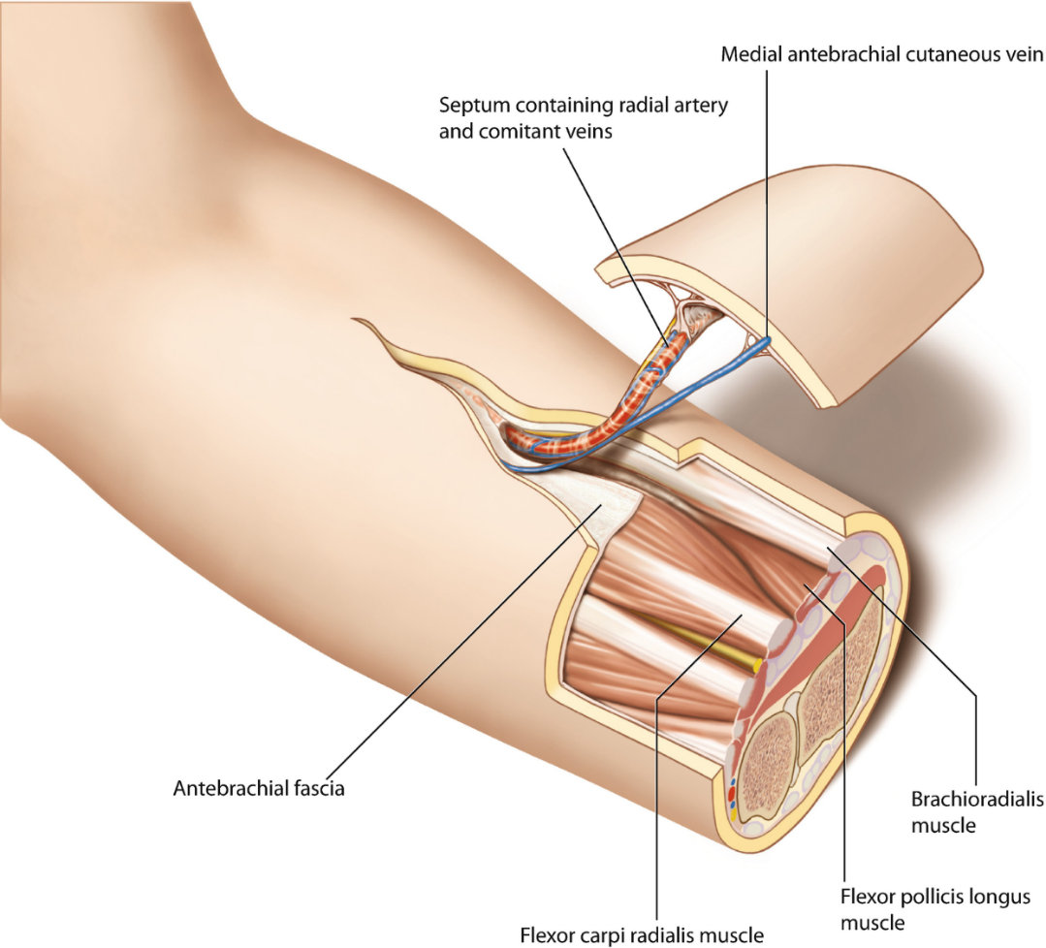
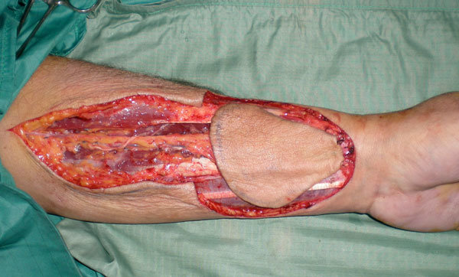
Free Radial Forearm Flap
Notes:
It is an extremely versa- tile flap allowing intricate folding of the skin, using two or more skin paddles/ islands, and incorporating vascularised tendon and/or bone (osteocutaneous flap).
The vascularity of the area allows considerable variation in the design and placement of this flap and offers the possibility of including bone as an osteocutaneous flap.

Slide 14
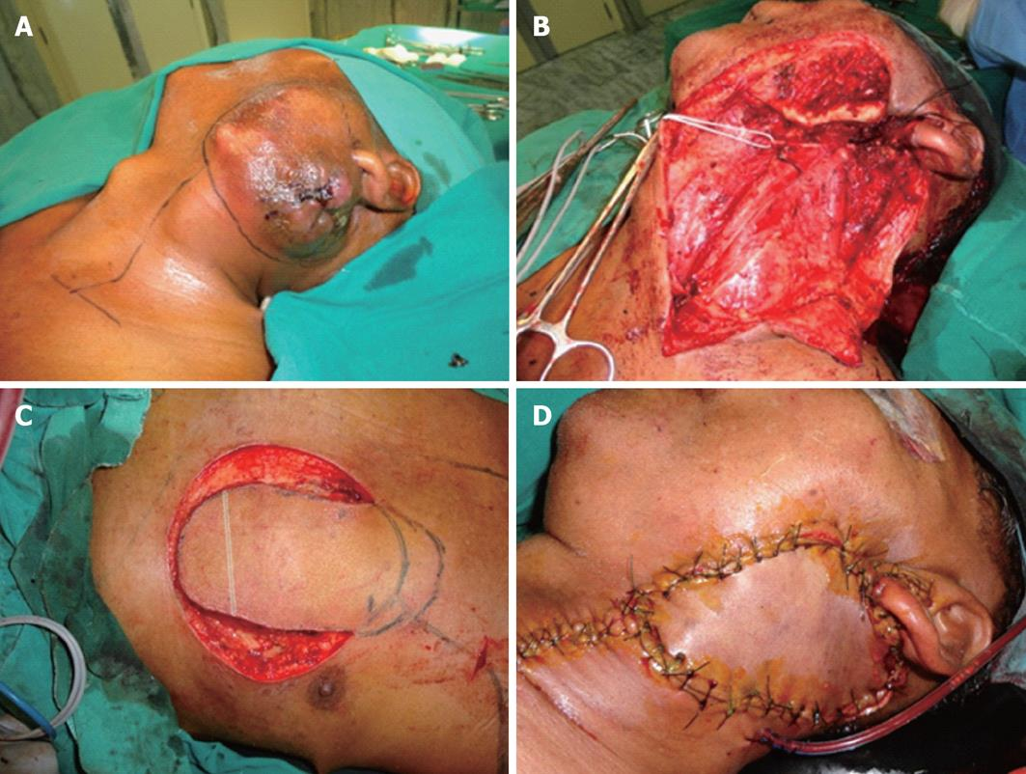
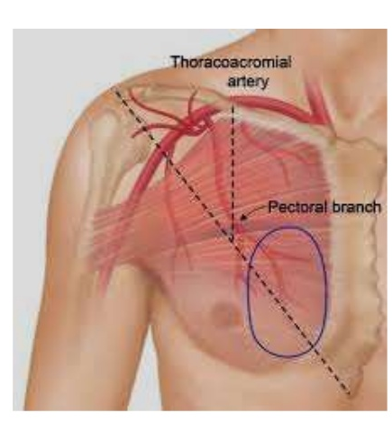
Pectoralis Major Flap

Slide 15
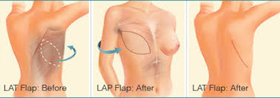
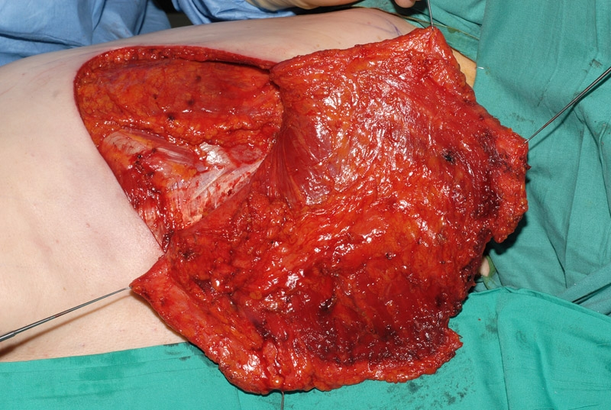
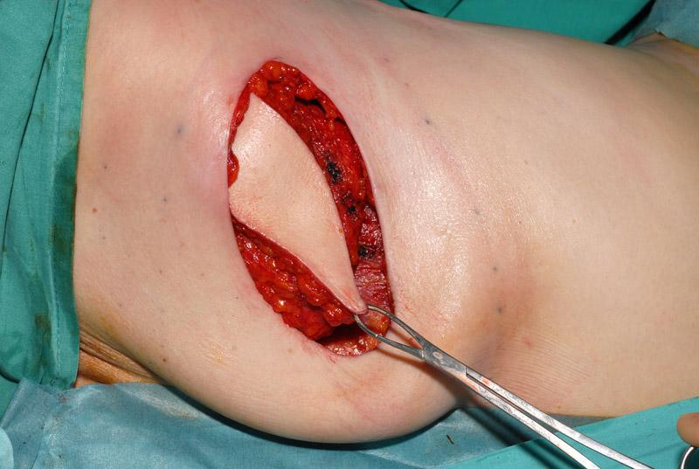
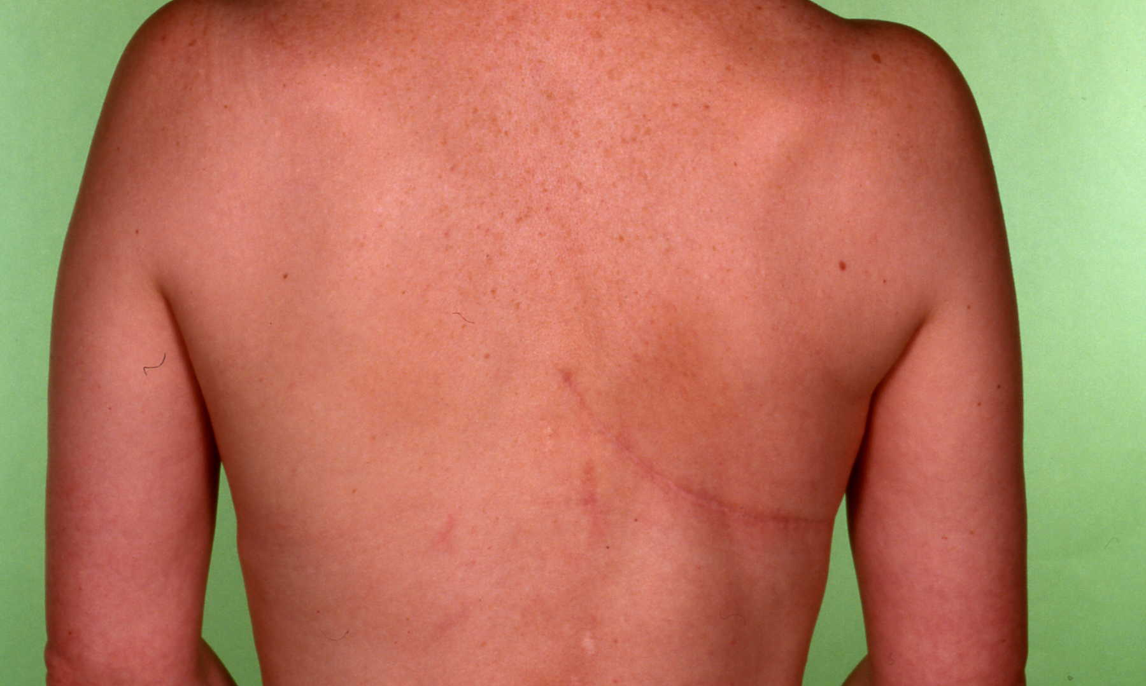
Latissimus Dorsi Flap

Slide 16
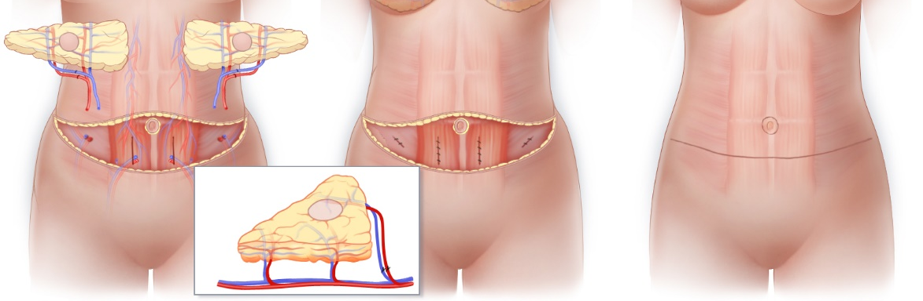
Deep Inferior Epigastric Perforator
(DIEP)

Slide 17
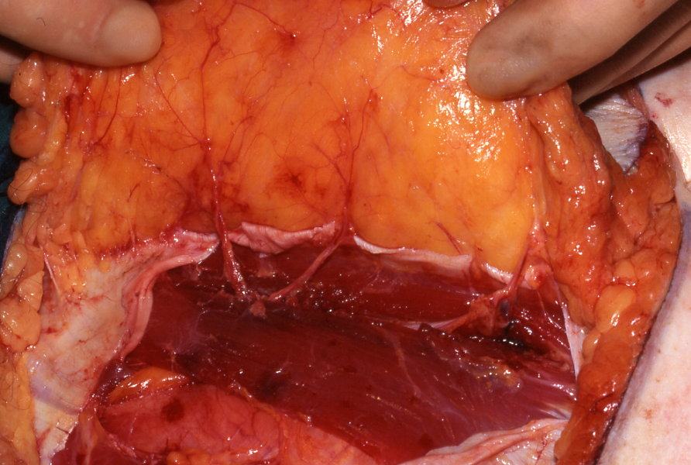
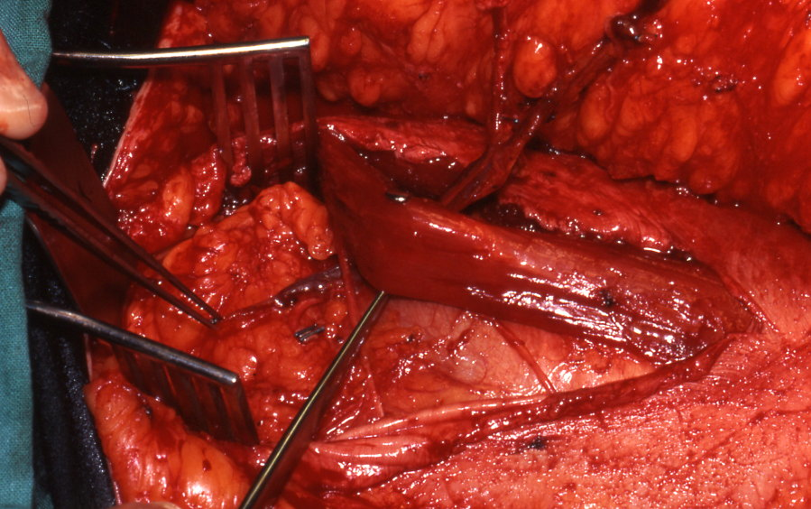
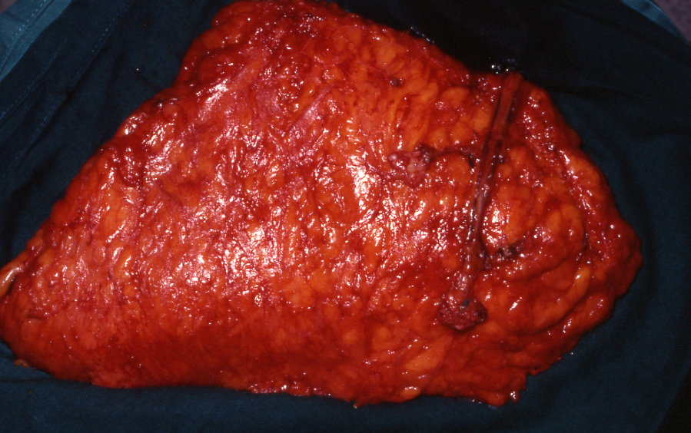
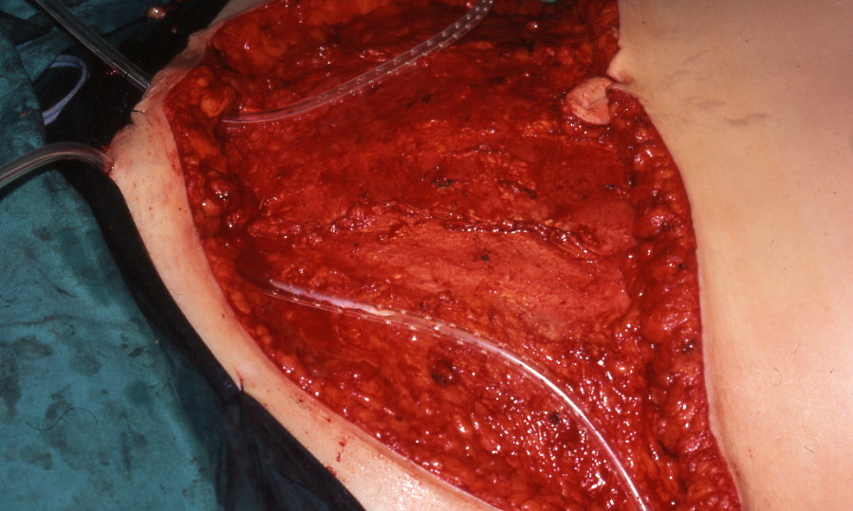

Slide 18
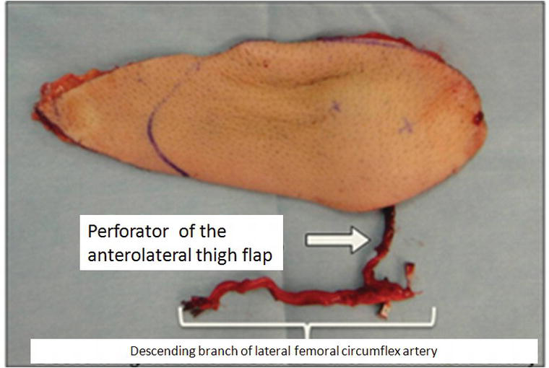
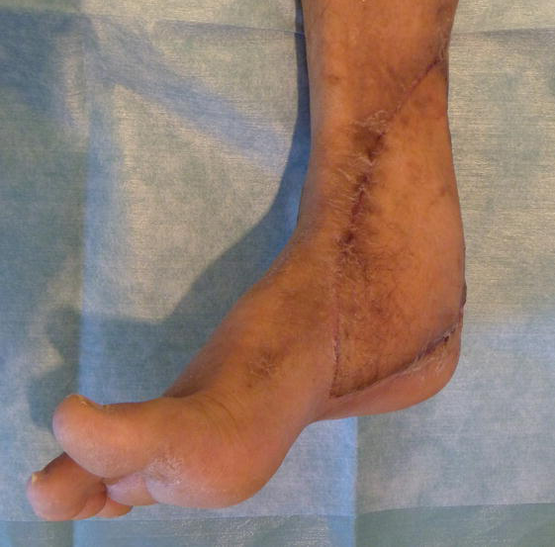
Antero-Lateral Thigh Flap (ALT)

Slide 19
Implications to Physiotherapy
Pain
Understanding of structures moved and their original purpose
“Bedding in” time
Dangling
Capillary refill & Graft/Flap failure

Slide 20
Pain
As with all post op mobility, regular pain relief if key to ensure patients can partake in their rehab and progress. Patients may have nerve blocks, pain relief infusions and analgesia after flap reconstruction.
Patients and likely to be painful at both the donor site and application site
With grafts, the donor site tends to be more painful/uncomfortable for patients. Can be itchy when healing. When moving in bed or mobilising patients can find this uncomfortable. This will improve over ~2weeks when the dressings can then be removed

Slide 21
Understanding of structures moved and their original purpose
Having a good understanding of the anatomy of where a flap has been taken from and where it has been placed is key in longer term rehab.
Example: If patient is tennis player or swimmer and they have had Lat Dorsi flap, this will be significantly affected due to the role this muscle plays in these sports.
Once a structure has been moved there may also be a tight closure of the wound which may limit rehab as it will likely take time and gradual stretching to relax surrounding skin to flexible movement.

Slide 22
“Bedding in” time
Read post op plan for instructions on mobilisation. Surgeons are normally very specific on when they would like patients to begin to mobilise.
Likely period of bedding in from ~1-7 days depending on graft/flap, location of graft/flap, stability of anastomosis (for flap) and patients compliance to treatment and rehab.
Once this period is over the patient can gradually increase level of mobility.
Occasionally consultants may shorten or extend bedding in period for a variety of reasons; poor/fast healing, bleeding, patient compliance.

Slide 23
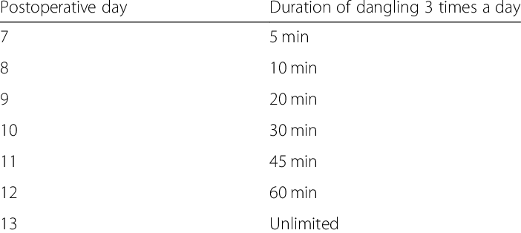
Dangling
Notes:
After recon the pt will likely Have the affected areas elevated for a period of time as specified in the post op instructions. After this time the pt will be allowed to dagle the afftedted areas. This will allow an increase in blood flor to the area. Pts may find this sensation dtrange and feel a significant amount of pressure the area due to the increase in blood pressure to the area. From the table we can see that this in gradyally increased over a number of days over the course of the day. Pts may not be able to manage this as the pressure can be very uncomfortable for patients esoecilly depending on the severity of the injury, Dangling is essential in the bedgiiing stages of rehab prior to mobilising. Although patients may not be allowed to mobilise or have the affected area danging this does not mean we cannot mobilise the patient, they can still sit out on a chair while keeping the area elevataed

Slide 24
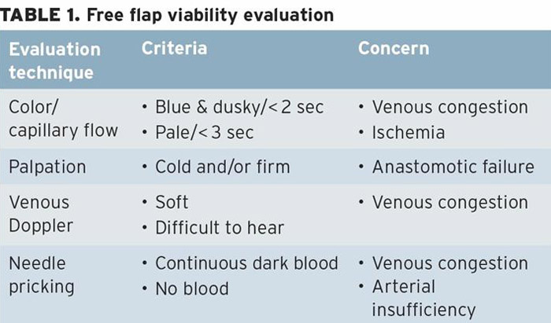
Capillary refill
The capillary refill time is generally thought to be the quickest assessment of early hypoperfusion. A delay in the capillary refill time (>2 seconds) indicates hypoperfusion of the skin.
Poor capillary refill can result in potential delayed healing and, in extreme case, flap failure if not identified early enough.

Slide 25
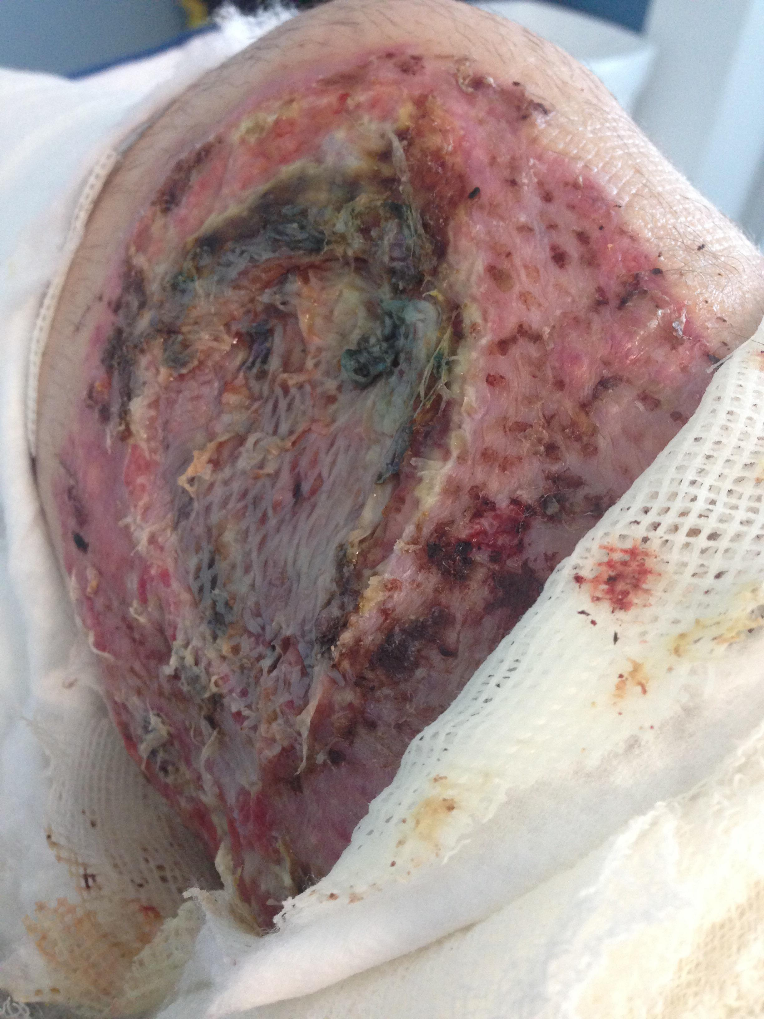
Graft Failure
The most common cause of graft failure is movement, which detaches any new blood vessel growth into the graft, depriving it of oxygen and nutrients. This complication causes fluid/blood collection between the graft and the graft site causing the graft to shear off.
Infection of graft site can cause graft failure. If infection is suspected cultures are taken from the graft site to determine the most appropriate antibiotic for use.

Slide 26
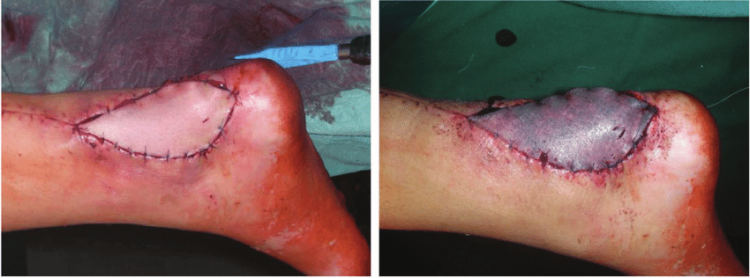
Flap Failure
Vascular compromise of free flaps most commonly occurs in the immediate postoperative period in association with failure of the anastomosis.
Vascular compromise can be diagnosed by inspection for colour change, diminished capillary refill, temperature, oedema, and general appearance.
Hematoma or seroma, i.e., collections of blood or fluid can collect under the flap causing poor vascularisation of the anastomosis and subsequent flap failure.

Slide 27
Thank you
Questions:
Jordann.Connaghan@ggc.scot.nhs.uk
Notes:
Thank you for watching this presentation. I hope it has given some basic insight into some of the plastic surgery techniques used in reconstruction and this this will affect the physiotherapy interventaion. If you have any questions feel free to contact

